Slide 1
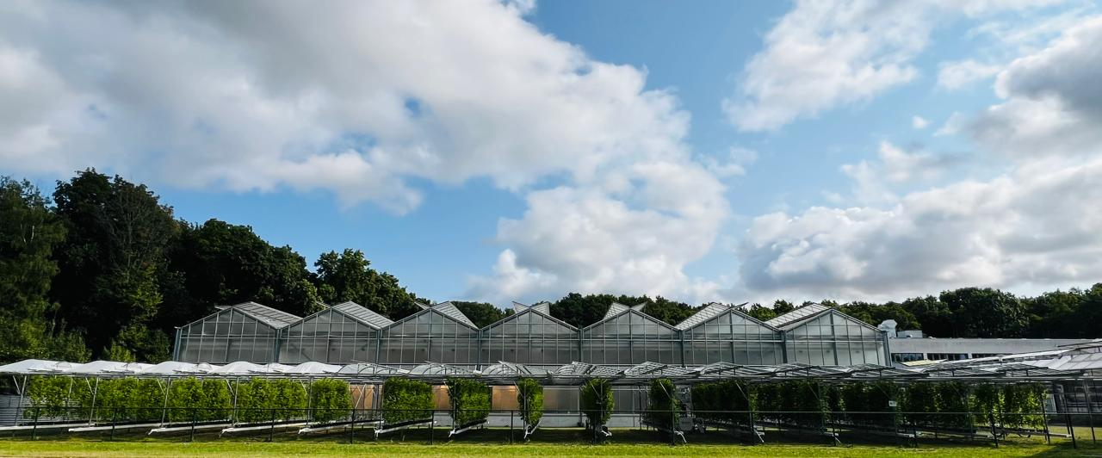



Agrivoltaics as a Dual Land-Use Strategy for the Sustainable Production of Long-Cane Raspberry cv. ‘Lagorai’ (Rubus idaeus L.)
Emeliane Kiladze, Christoph Jedmowski, Otavio dos Anjos Leal, Matthias Meier, David R. Bryla, Onno Muller
Notes:
Good afternoon, everyone.
My name is Emeliane Kiladze, and today I’m pleased to present my research on ‘Agrivoltaics as a Dual Land-Use Strategy for the Sustainable Production of Long-Cane Raspberry cultivar ‘Lagorai.’
This research has been conducted in Germany, at the Juelich Research Centre, which is the largest research center in Europe and one of the leading institutions for plant science.
The project was carried out under the supervision of Drs. Onno Müller, Matthias Meier, Christoph Jedmowski, Otavio dos Anjos Leal and David R. Bryla

Slide 2
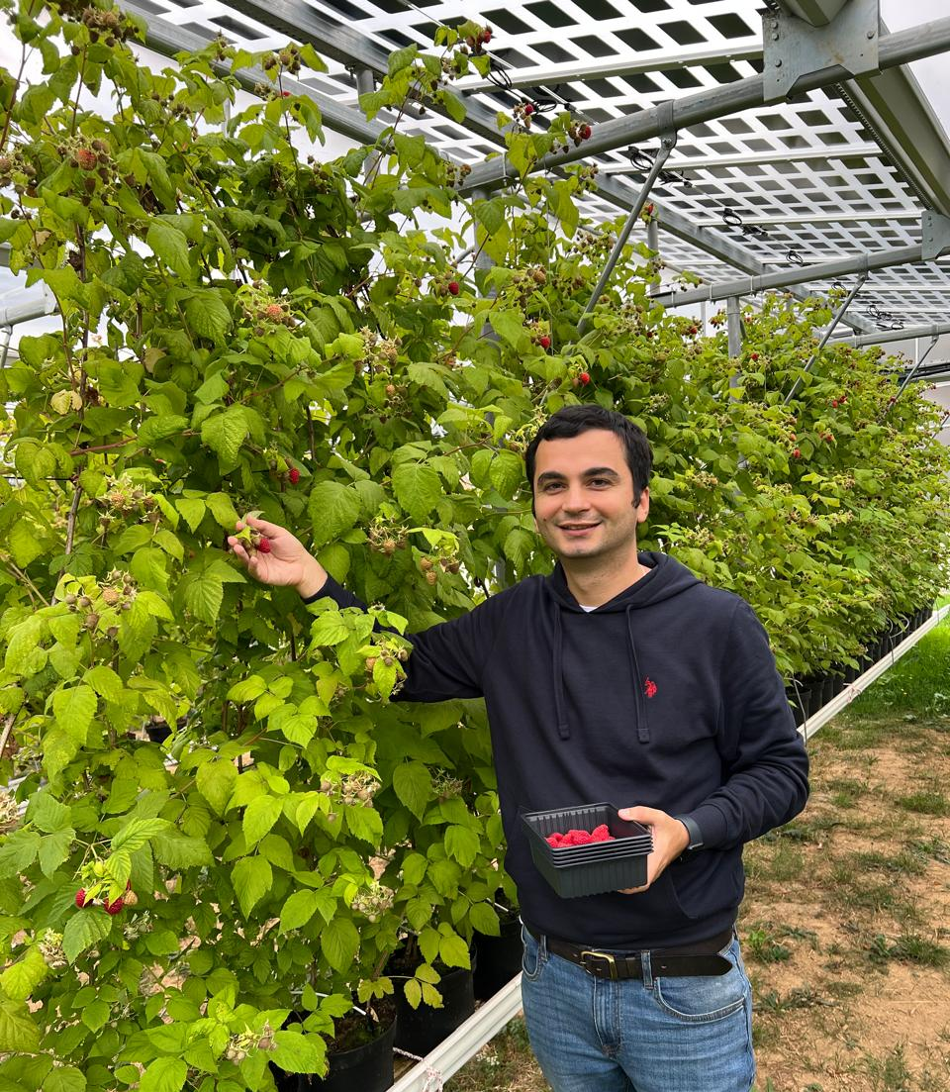
About me – personal background
Education
2021-25 - Ph.D. degree in Agricultural Science with honours – summa cum laude (Agricultural University of Georgia);
2020-21 - Blueberry Physiology, Production Systems & Management Course (Oregon State University);
2010-17 - Master’s and Bachelor’s degree in International Law with honours (Tbilisi State University).
Work experience
2025 - until now - Postdoctoral Fellow at Juelich Research Centre, Institute of Bio- and Geosciences, Plant Sciences (IBG-2);
2023 - until now - Consultant in new technologies and scientific research for blueberry production at Blueberry Farm company LLC ‘Blue Bash”;
2021-2023 - Co-founder and Director of Blueberry Farm LLC ‘Blue Bash’ at my home city, Samtredia in Georgia.
As a specialist in Agricultural Science and International Law, I have extensive experience in international projects, scientific outreach, and collaborative research.
Notes:
Currently, as a Postdoctoral Fellow I’m working at the Institute of Plant Sciences in the largest research centre in Europe.
My first profession is a international law and my path from law to agriculture began with a strong interest in sustainable food systems and environmental challenges and, of course, a love for healthy berries.
This passion led me to combine scientific research with practical experience, especially as a researcher exploring innovative systems like agrivoltaics

Slide 3
Research relevance and novelty
  Relevance
  Enhances sustainable horticulture and climate adaptation
  Promotes dual use of land: food + renewable energy
  Provides farmers with evidence-based results → reduces risk of mistakes before adoption
  Novelty
  Very limited scientific knowledge on raspberries under agrivoltaics (some trials exist, but not comprehensive)
  First comprehensive physiological study on long-cane raspberry (Rubus idaeus L. ‘Lagorai’*) under agrivoltaics
Reference: Agrivoltaics Map database (https://agrivoltaicsmap.github.io/Facilities/)
Notes:
My research about ‘Agrivoltaics as a Dual Land-Use Strategy for the Sustainable Production of Long-Cane Raspberry,’ focuses on integrating renewable energy generation with sustainable horticulture and climate adaptation
That Agrivoltaics allows dual land use for both food and renewable energy what helping farmers increase efficiency and resilience.
It also provides science-based data to reduce uncertainty before adopting new systems.
The novelty lies in the fact that there is very limited research on raspberries under agrivoltaic systems.
My work is the first comprehensive physiological study on the long-cane raspberry under agrivoltaic conditions.

Slide 4
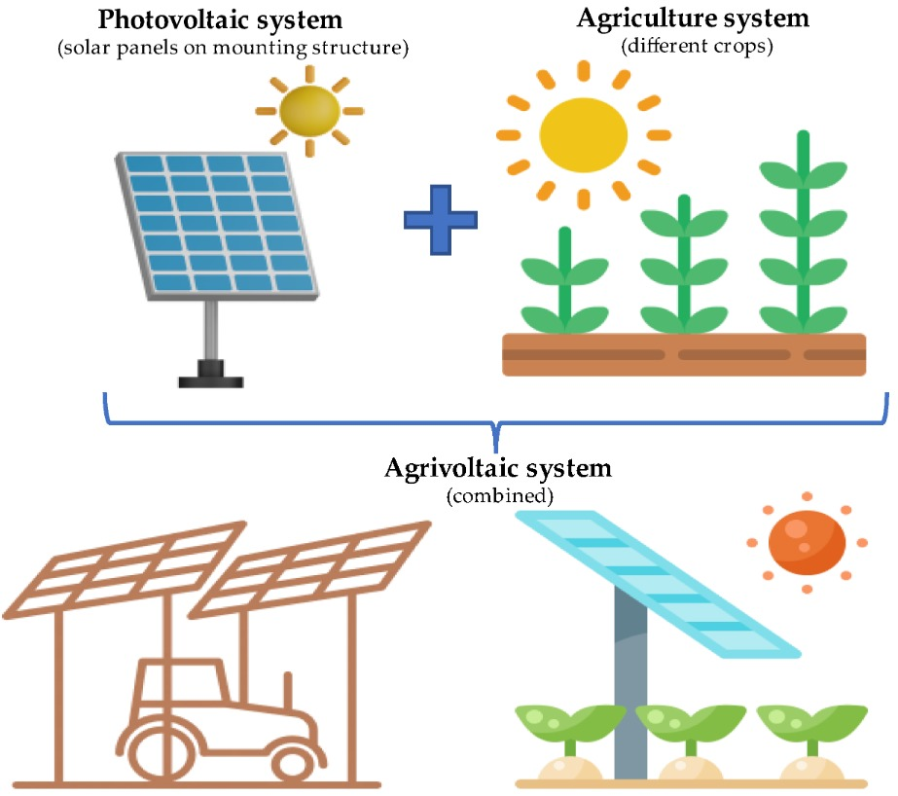
Literature review
History
The concept of agrivoltaics was introduced in 1981 by German physicist Prof. Dr. Adolf Goetzberger, a pioneer of solar energy.
Together with Prof. Dr. Armin Zastrow, he published the first paper in the International Journal of Solar Energy (1981), giving birth to the idea of combining agriculture with solar energy production.
Scientific Insights
Agrivoltaics provides a win–win–win for farming, renewable energy, and society.
Documented benefits include:
  Improved water-use efficiency
  Soil temperature regulation (climate buffering)
  Increased soil carbon storage
  Enhanced pollinator activity and ecosystem services
  Improved yield (up to 60%)
Notes:
The concept of agrivoltaics, was first introduced in 1981 by the German physicist Professor Adolf Goetzberger together with Professor Armin Zastrow, who proposed combining solar energy production with agriculture. Their pioneering idea laid the foundation for today’s dual land-use systems.
Over the past decades, research on agrivoltaics has expanded rapidly, especially in crops such as lettuce, tomato, and potato, demonstrating that agrivoltaics can create a ‘win–win–win’ situation that benefiting farming, renewable energy, and society.
However, despite this progress, very little is known about berry crops, including raspberries, under agrivoltaic conditions.

Slide 5
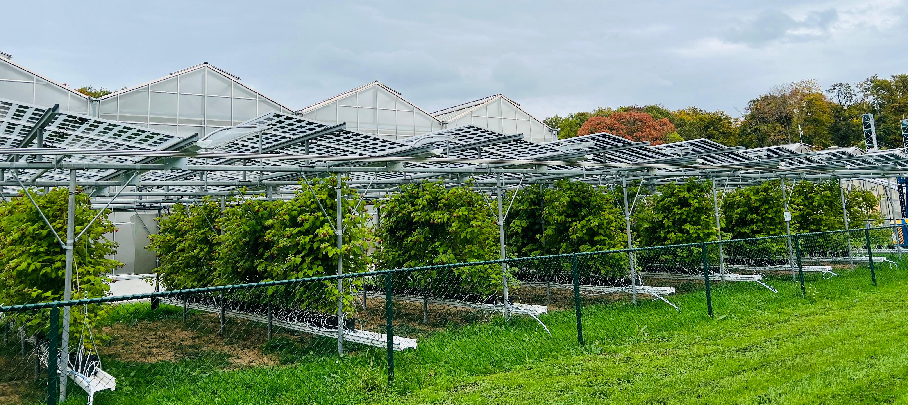
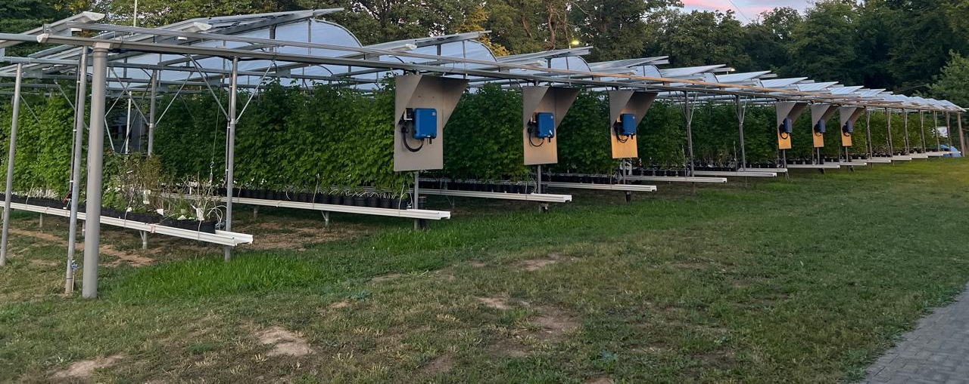
Research goals
To analyze plant growth, ecophysiology, and yield under different shading treatments.
To contribute new insights for berry production under dual land use.
Notes:
Based on these research gaps, my study aimed to:
Analyze plant growth, physiology, and yield of long-cane raspberries under different levels of shading created by solar panels.
Provide insights that can help farmers and researchers adapt this dual land-use model for high-value horticultural crops.

Slide 6
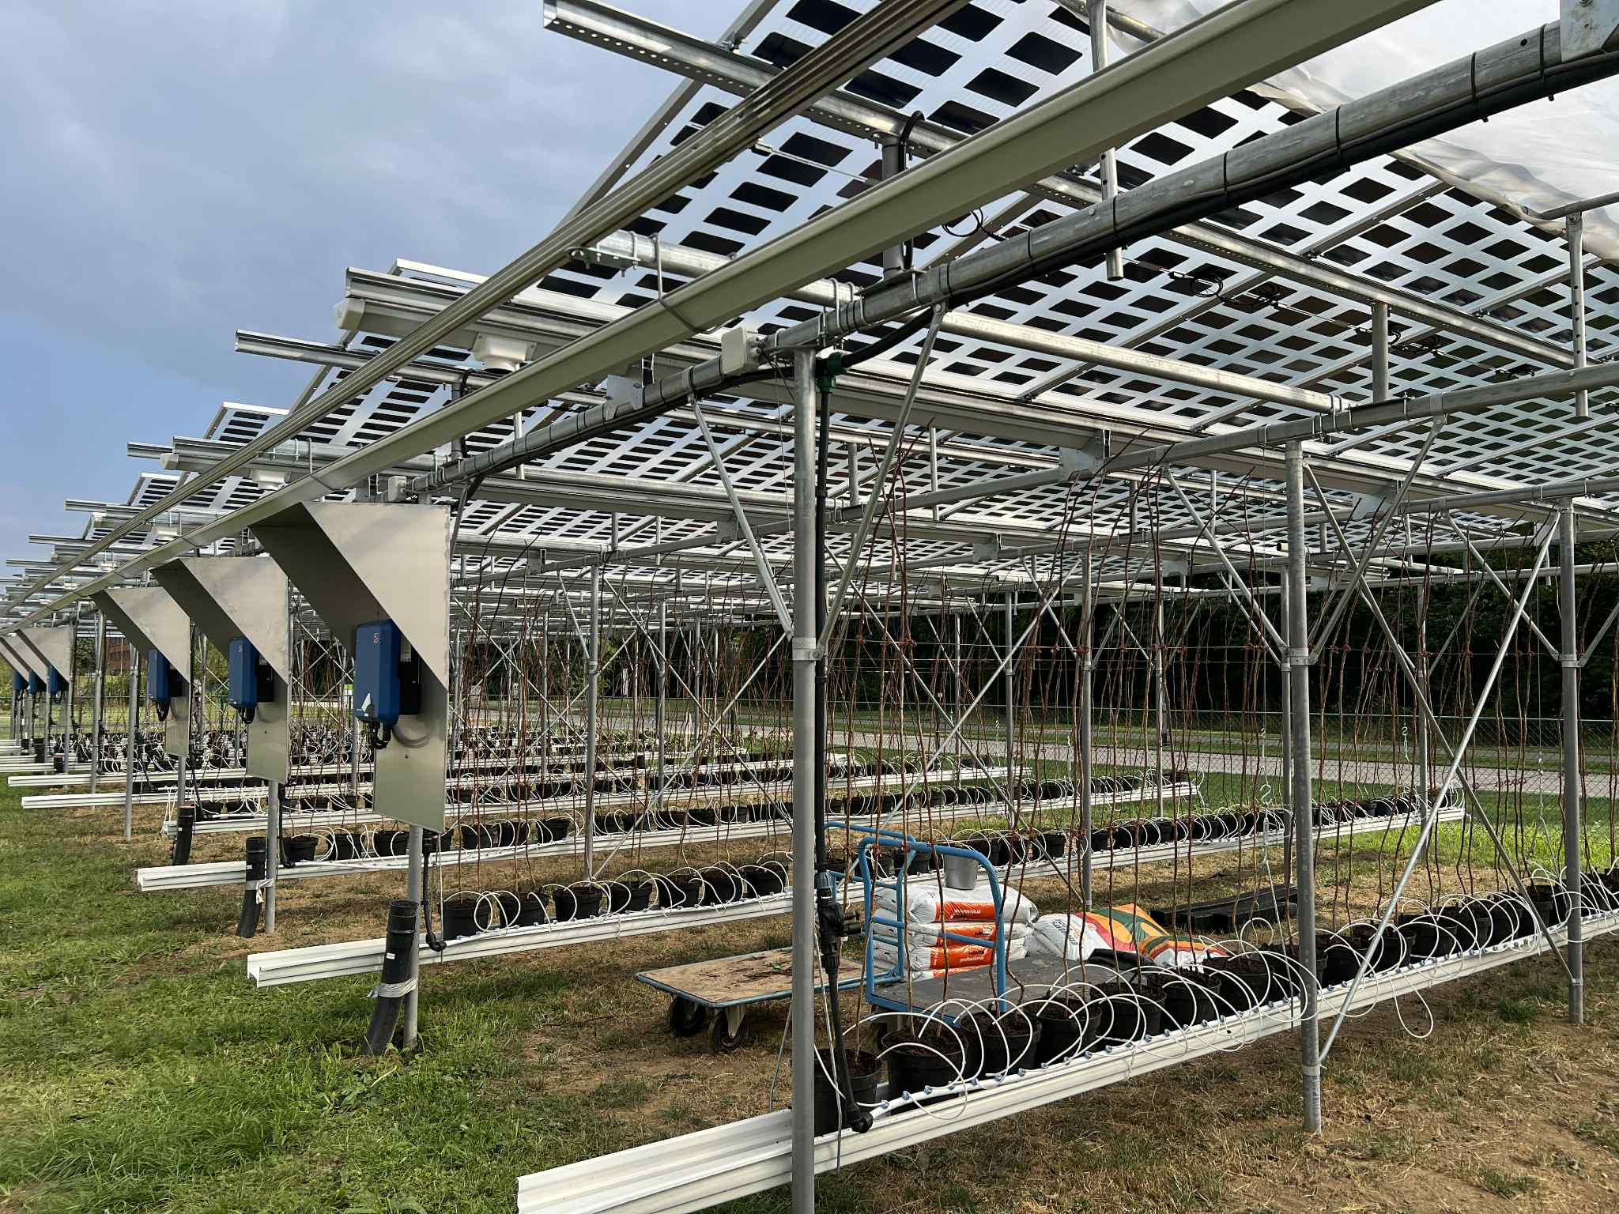
Research materials
Plant Material
400 long-cane raspberry plants (Rubus idaeus L. cv. ‘Lagorai’), 15 rows
Variety chosen because:
  Produces harvest in the first year (long-cane system)
  Widely used in commercial production and experimental trials
  Popular cultivar with high market acceptance
Experimental Treatments (roofs)
40% shade – semi-transparent solar panels
60% shade – higher shading solar panels
Plastic roof – control treatment
Solar panels were applied as roofing structures, chosen for their proven energy performance in previous studies, and to represent both minimum and maximum relevant shading scenarios.
Management Practices
Fertilization, pesticide application, and irrigation were identical across all treatments, following standard commercial raspberry production practices
Notes:
I used 400 long-cane raspberry plants the cultivar Lagorai that arranged in 15 rows.
This variety was selected because it can produce fruit in its first year and is well-known in commercial production.
The experiment included three types of roofs:
– 40% shading using semi-transparent solar panels,
– 60% shading using more opaque panels, and
– a plastic roof serving as the control.
All management practices, including fertilization, irrigation, and pest control, were identical across treatments.

Slide 7
Research objectives and methods
Objectives
Assess physiological, growth, and yield responses of raspberry under different shading treatments
Provide quantitative data for sustainable berry production in agrivoltaics (APV) systems
Methods and Measurements
Photosynthesis and stomatal conductance
SPAD (chlorophyll content)
Biomass: fresh and dry weight
Leaf traits: Specific leaf area (SLA)
Shoot growth: Branch size
Reproductive traits: Number of flowers and number of fruits
Fruit quality: Weight of fruits, diameter and length of fruits, and Brix
Environment: Soil temperature, soil moisture, photosynthetic active radiation (PAR light), and air temperature
Statistical analysis:
Data were analyzed using ANOVA and Tukey’s HSD test (p < 0.05) and presented as mean ± SD.
Notes:
To reach the goal of my research that to understand how different levels of shading created by agrivoltaic effect the physiology, growth, and productivity of long-cane raspberries we:
Assessed shading influences on photosynthesis, leaf traits, and biomass accumulation.
Evaluated that how these physiological changes translate into flowering, and fruit development.
And quantified the yield and fruit quality under different shading conditions. All collected data were statistically analyzed using ANOVA and Tukey’s HSD test to determine significant differences among treatments.
Together, these parameters provide a comprehensive picture of how raspberries respond to varying shading intensities under agrivoltaic conditions, that answering the main research question:
If long-cane raspberries maintain optimal growth and fruit quality under reduced light conditions created by agrivoltaic systems?”

Slide 8
results : Environment pot and air
The different PV panels had almost no effect except for a small decrease (<2%) in soil temperature and air humidity with 60% PV shade.
Notes:
We continuously measured soil and air parameter.
Although small differences were observed, the overall environmental conditions were similar between treatments.
This shows that the agrivoltaic structure itself had minimal impact on the microclimate — which is a positive finding.

Slide 9
Results: leaf traits
Dry weight of leaves was significantly lower under solar panels. For result to measure Specific Leaf Area (SLA) it is revealed that thinner leaves with more light-capturing surface under solar panels
Notes:
The dry weight per leaf was significantly lower under the solar panels. it indicates that leaves under panels may retain more moisture that is another possible advantage in hot climates for water consumption
For the specific leaf area, which is the ratio of leaf area to dry mass, we found that leaves under solar panels were thinner but had a larger light-capturing surface.
This adaptation enhances light use efficiency under shaded conditions.

Slide 10
Results: Leaf photosynthesis and chlorophyll
Both parameters were slightly higher in the control, followed by 60% and then 40% shading. Differences were not statistically significant, suggesting that raspberries tolerate shading well, though long-term studies are needed to confirm.
The Chlorophyll contentment were significantly lower in the control compared to solar panels treatments, indicating higher chlorophyll under shading. No significant differences were observed between the two solar panel treatments.
Notes:
we also measured photosynthesis and stomatal conductance using a LI-COR device across varying light levels and the shaded plants also showed higher chlorophyll levels.
it indicate that raspberries tolerate shading quite well. However, Long-term trials is need to confirm this resilience.

Slide 11
Results: flower and fruit
The total weight of 15 fruits was 76.9 g in the control, 85.4 g under 40% shade, and 65.9 g under 60% shade. Although slight differences were observed among treatments, further long-term experiments are needed to confirm these trends.
Notes:
We analyzed the fruit quality paramenters as a number of flowers, fruits, fruit diameter, length, weight, and soluble solids.
The total weight of 15 fruits was 76.9 grams in the control, 85.4 grams under 40% shading, and 65.9 grams under 60% shading.
While the differences were moderate, they indicate that 40% shading may be the most favorable condition.
Further multi-year data will be essential to confirm this trend

Slide 12
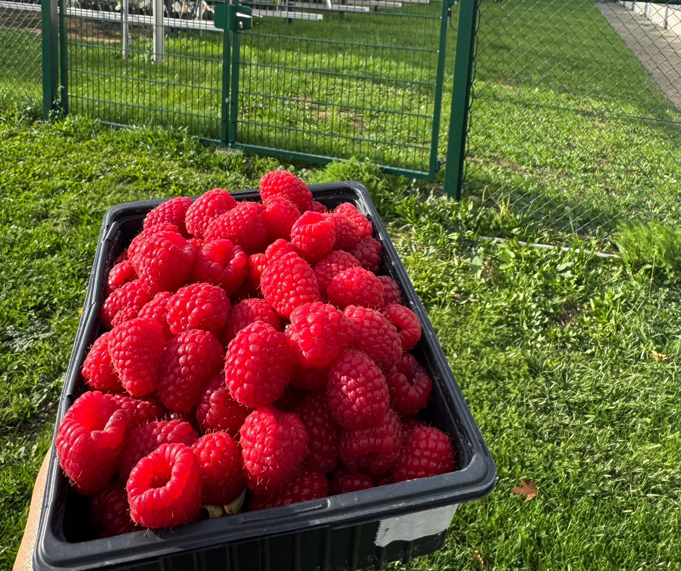
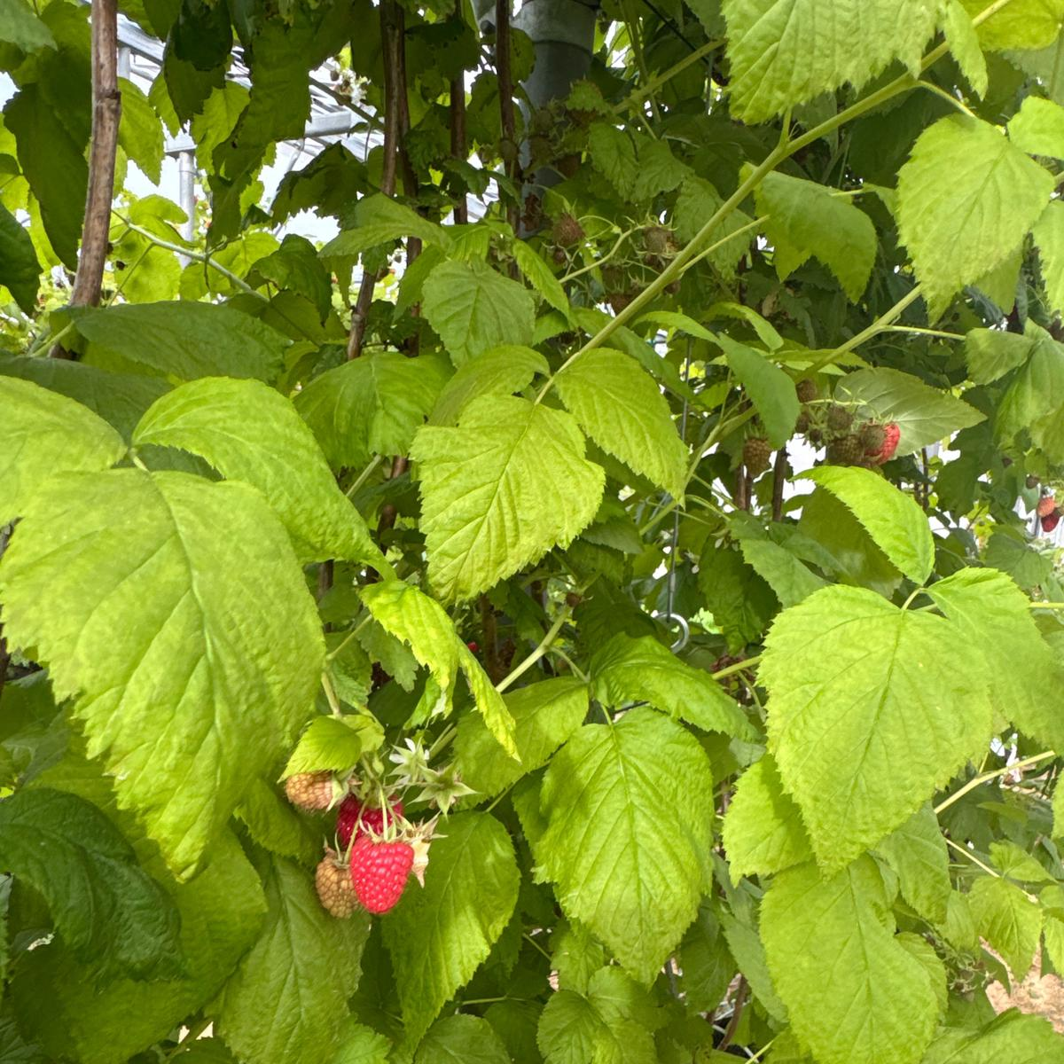
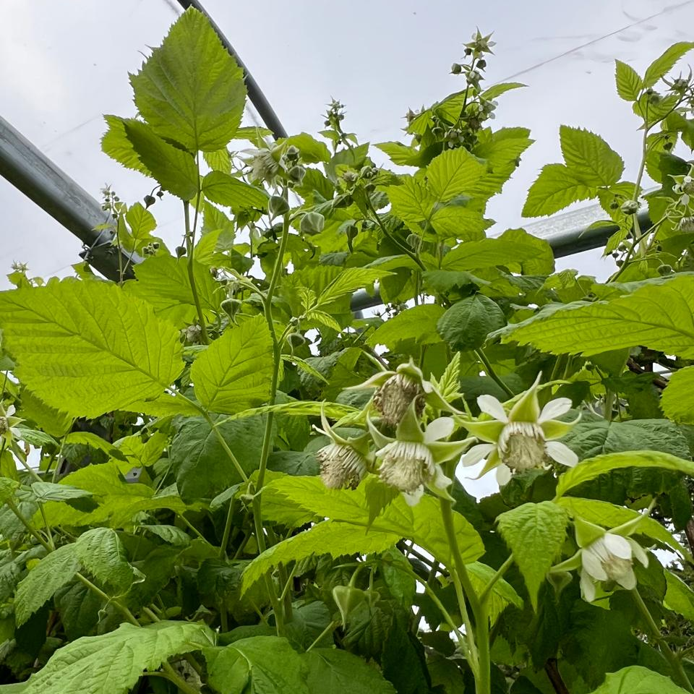
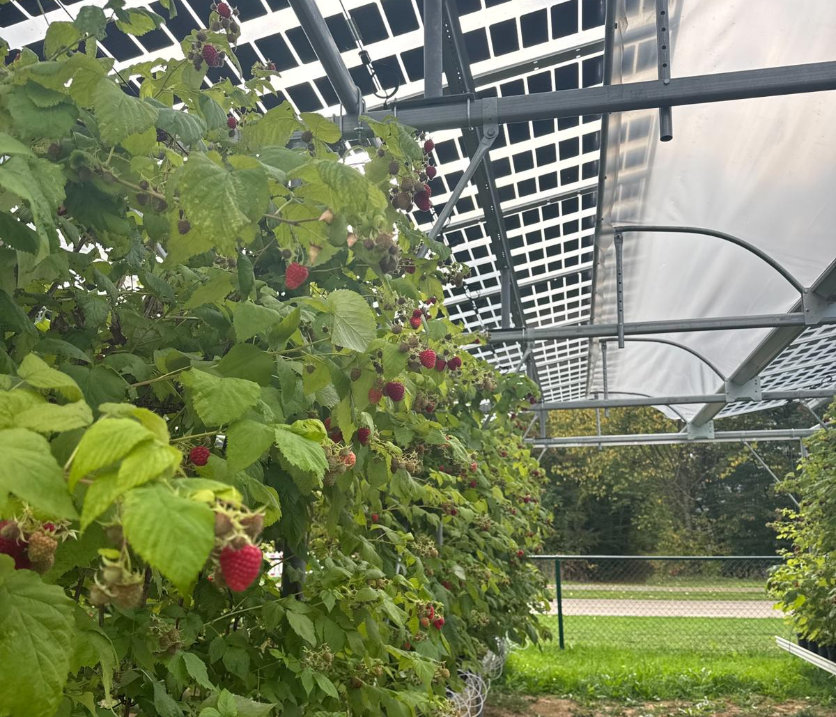
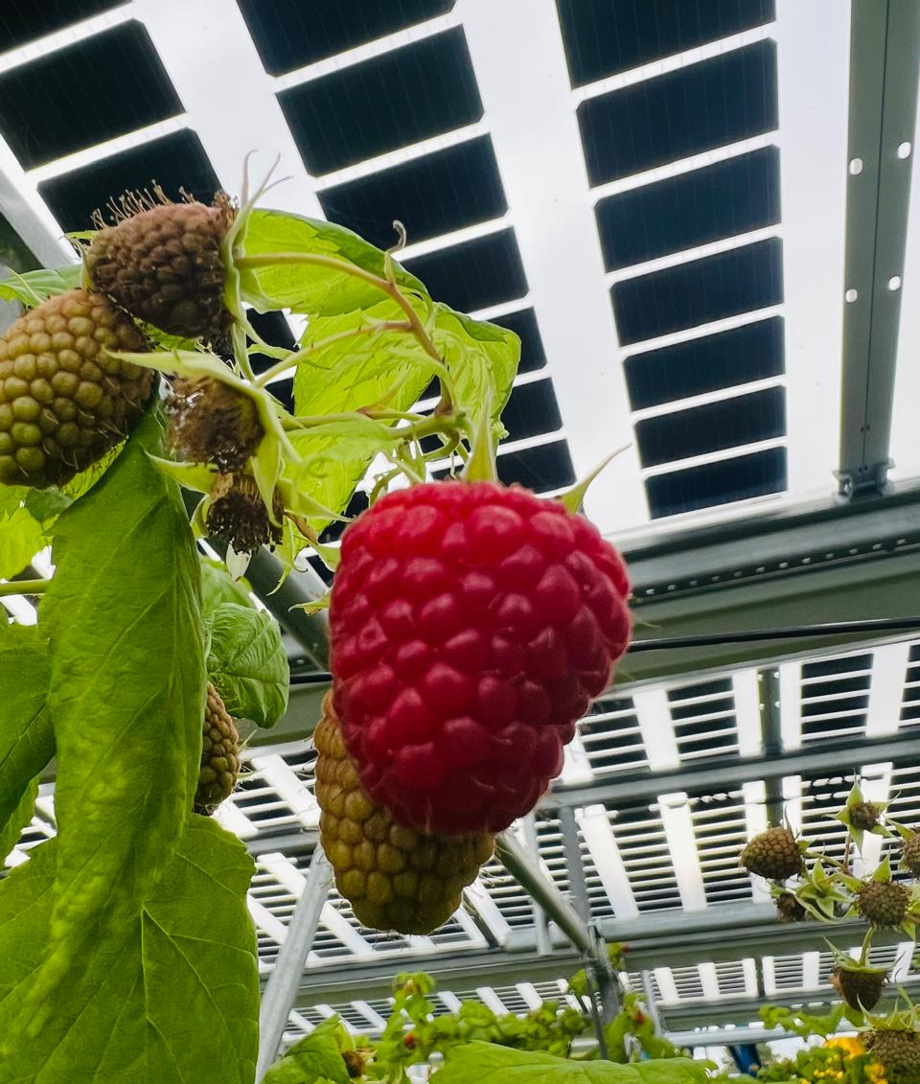
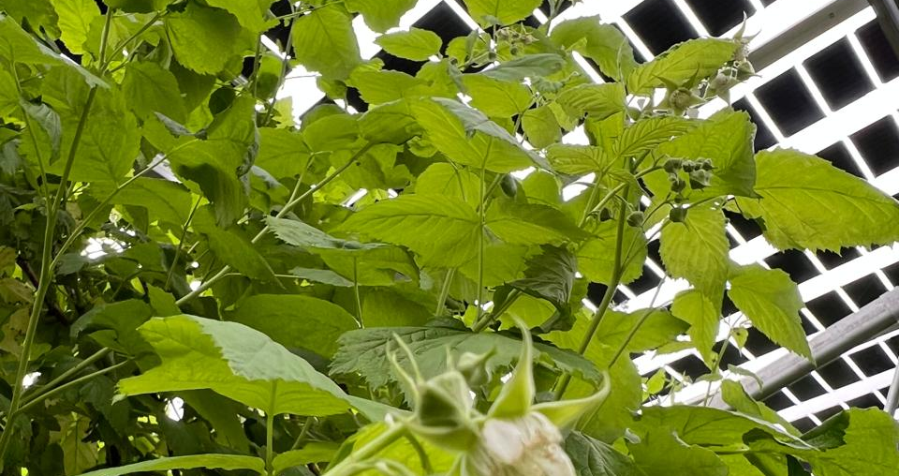
Conclusion and recommendations
Agrivoltaics shows potential for raspberries under shading.
Moderate shading (40%) improved leaf physiological traits, while 60% shading slightly reduced photosynthetic activity
Shading delayed fruit ripening:40% shade by 2 days and 60% shade by 3 days compared with the control
Recommendation: continue long-term trials and test in different clime zones
Notes:
To conclude, agrivoltaics shows strong potential for raspberry cultivation.
Different shading levels influence physiological traits, growth, and yield, however overall, raspberries demonstrate a good tolerance to shading.
One particularly interesting finding was the difference in fruit ripening time — fruits grown under 40% shading ripened about two days later than those under the plastic roof, while fruits under 60% shading ripened about three days later.
This shift in ripening time allows farmers to extend the raspberry harvesting period, helping them manage labor more efficiently and reach better market prices by spreading production over a longer timeframe.
Overall, these results highlight that moderate shading (around 40%) can provide both physiological benefits and practical advantages for production scheduling.
I recommend continuing long-term trials and testing different climate zones to refine these findings and support the broader adoption of agrivoltaic systems in berry production

Slide 13
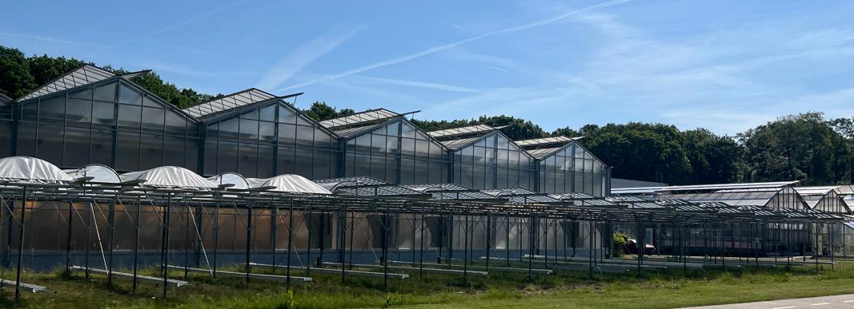
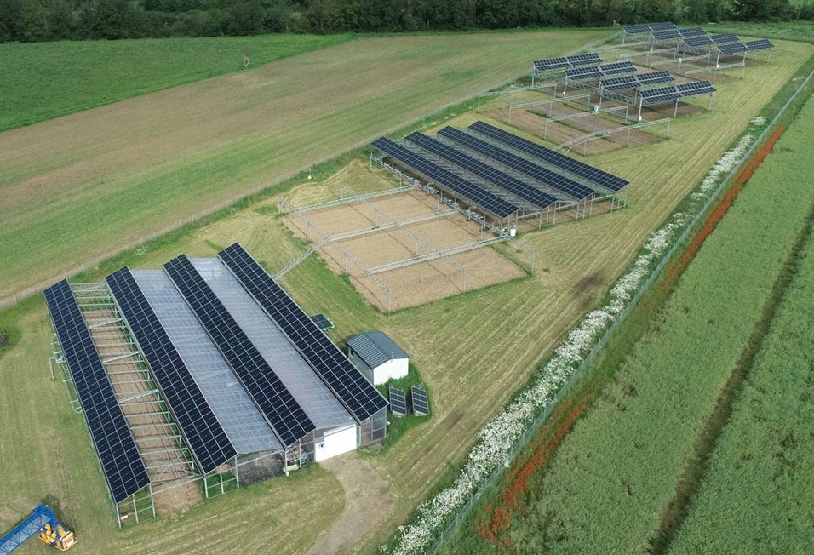
Future plans
Extend raspberry trials (year 2 and 3) at Juelich Research Center
Expand to blueberry cultivation under different configurations of APV at Juelich Research Center
Notes:
My next step is to extend these raspberry trials into the second and third years, to observe long-term responses.
In parallel, I plan to expand the research to blueberry cultivation under different photovoltaic configurations that combining my expertise with this direction.

Slide 14
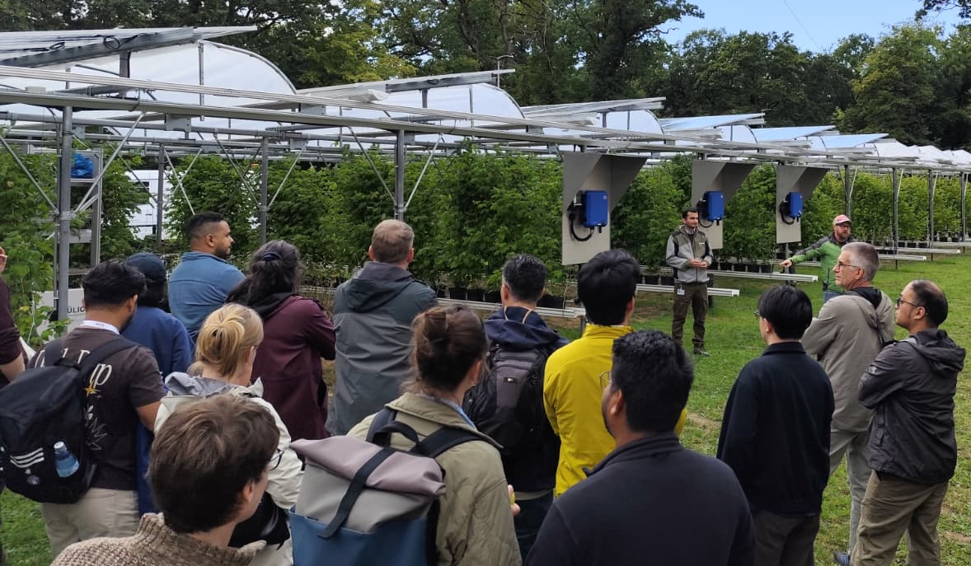
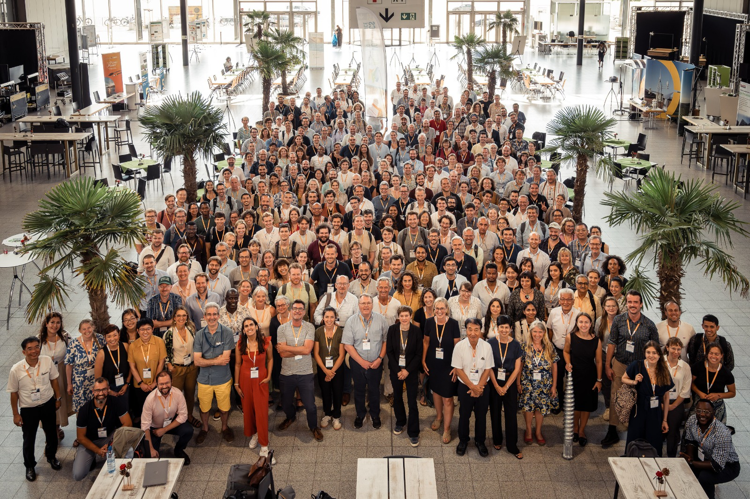


Dissemination
Presented my research :
-6th Agrivoltaics World Conference
-European Plant Phenomics Symposium (EPPS)
Planned presentations:
  32nd International Horticultural Congress (IHC 2026, Japan).
  7th Agrivoltaics World Conference (India).
Publications in peer-reviewed journals.
Outreach to growers and stakeholders.
Notes:
I already presented this research on different scientific events and will be shared at major international conferences, including the International Horticultural Congress in Japan and the Agrivoltaics World Conference in India.
Publications are planned in peer-reviewed journals, and I also aim to communicate findings directly to growers and stakeholders

Slide 15

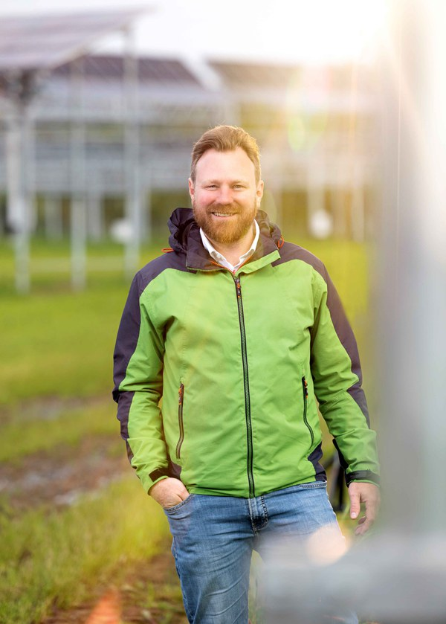
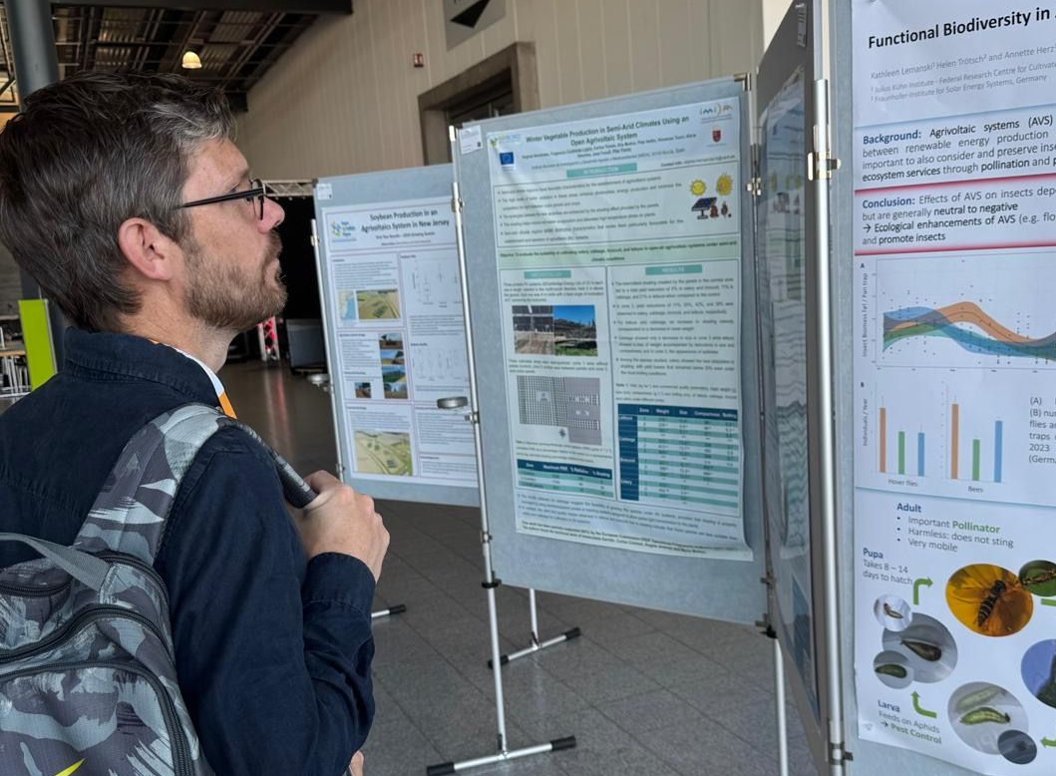
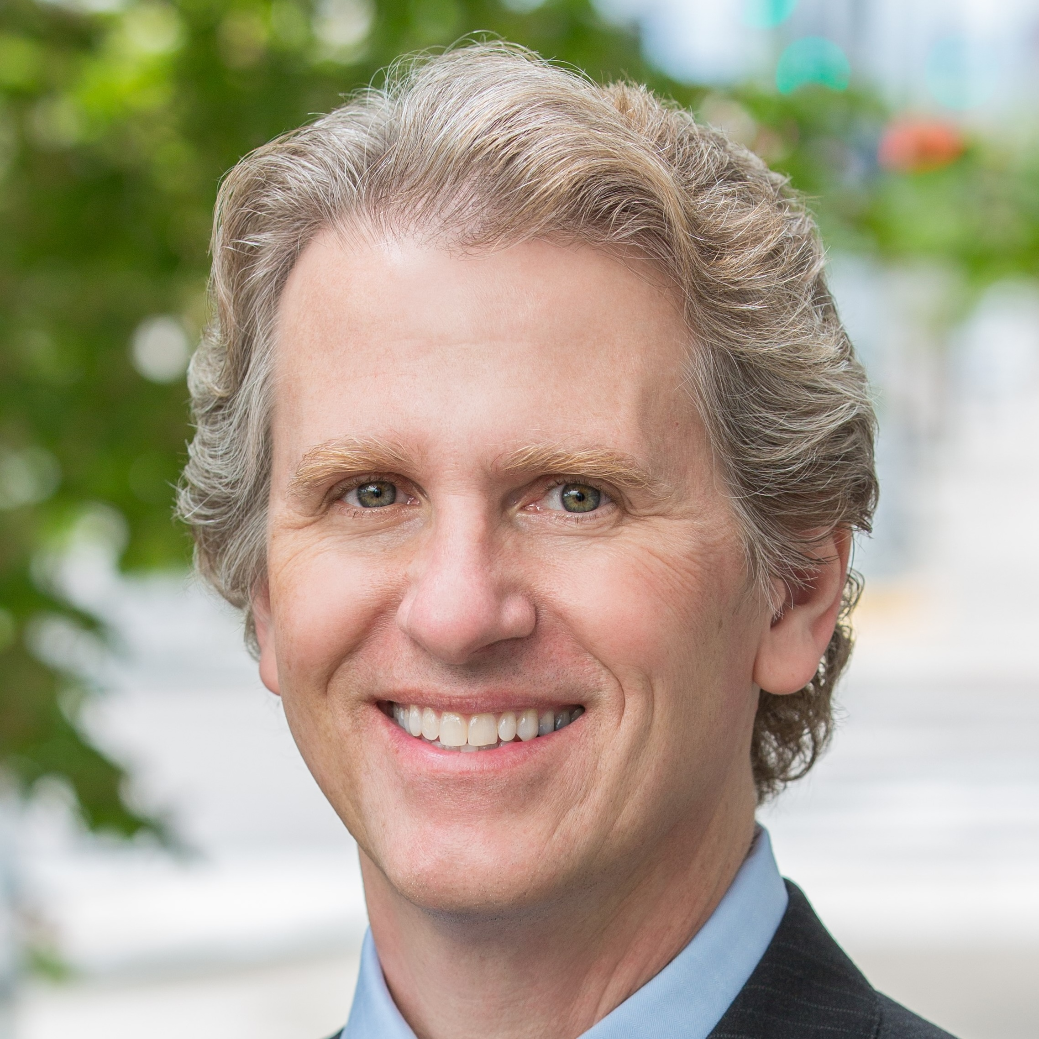
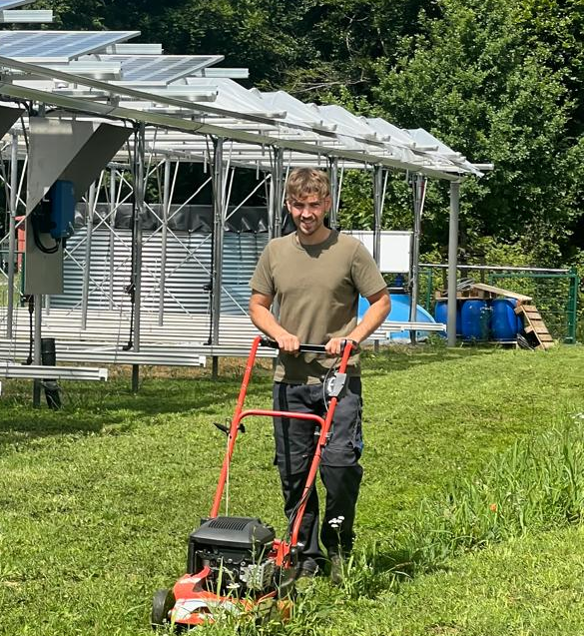
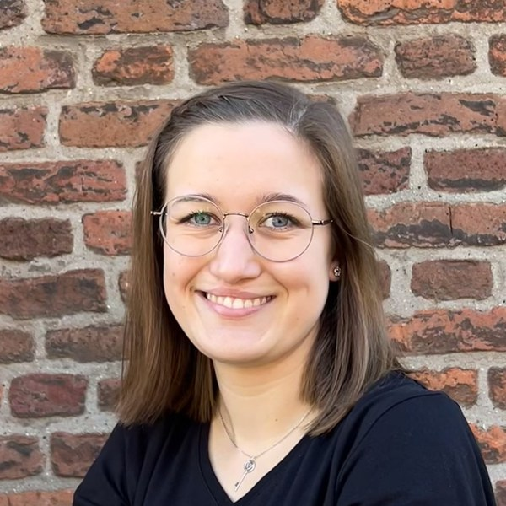
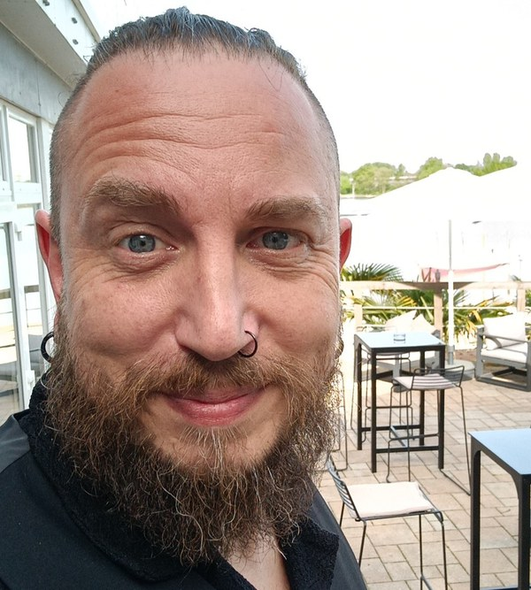
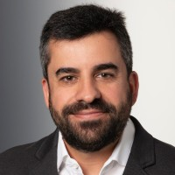
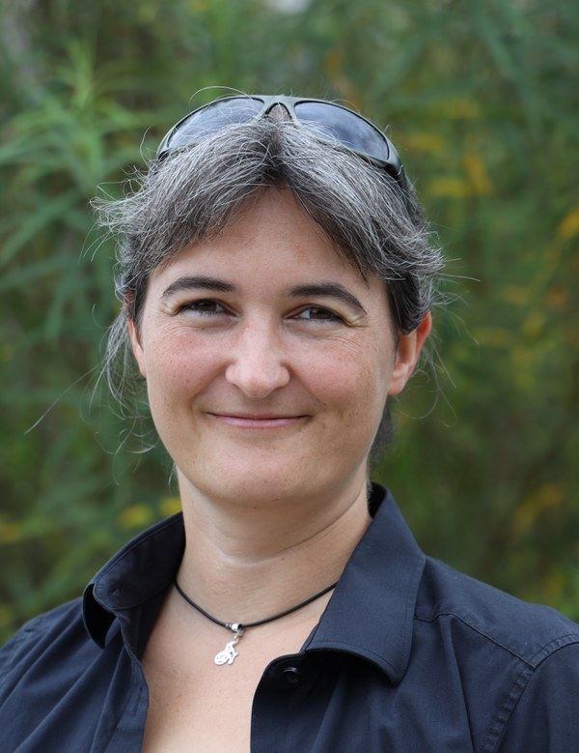
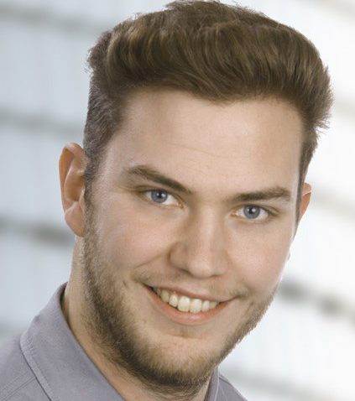
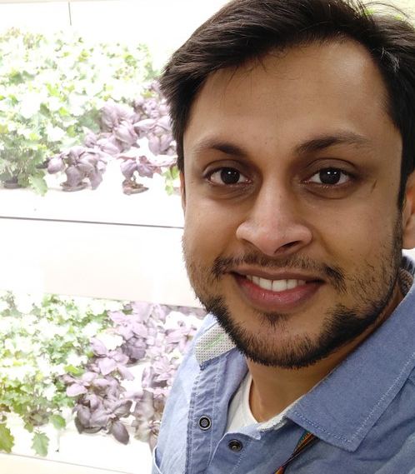
Acknowledgements
German Academic Exchange Service (DAAD Georgia).
Juelich Research Centre, Institute of Bio- and Geosciences, Plant Sciences (IBG-2).
Agricultural University of Georgia.
Colleagues and collaborators.
Questions?
Notes:
I would like to express my sincere gratitude to the DAAD Georgia office, the Juelich Research Centre’s IBG-2 institute, the Agricultural University of Georgia where I awarded the PhD Degree in Agricultural Science, and all my colleagues and collaborators for their support in this project
Thank you very much for your attention.
I’ll be happy to take any questions or comments

Slide 16
Agrivoltaics as a Dual Land-Use Strategy for the Sustainable Production of Long-Cane Raspberry cv. ‘Lagorai’ (Rubus idaeus L.)
Emeliane Kiladze, Christoph Jedmowski, Otavio dos Anjos Leal, Matthias Meier, David R. Bryla, Onno Muller

